Slide 1

Predictive Analysis
Liver Disease
Barbara Payne

Slide 2
Liver Disease
Vital organ
Many functions
2 million deaths per year
Symptoms
Diagnosis
Treatment
Prevention

Slide 3
Predictive Analysis
Uses historical data to make predictions
Can include big data, data mining, and machine learning
Many benefits
Used in a variety of industries

Slide 4
Dataset
https://www.kaggle.com/uciml/indian-liver-patient-records
583 records
11 variables
Patients from North East of Andhra Pradesh, India
Feature Variables
Age
Gender
Total Bilirubin
Direct Bilirubin
Alkaline Phosphotase
Alamine Aminotransferase
Aspartate Aminotransferase
Total Protiens
Albumin
Albumin and Globulin Ratio
Dataset: field used to split the data into two sets (patient with liver disease, or no disease)

Slide 5
Methods
Exploratory Data Analysis
Train and test
Predictive Analysis

Slide 6
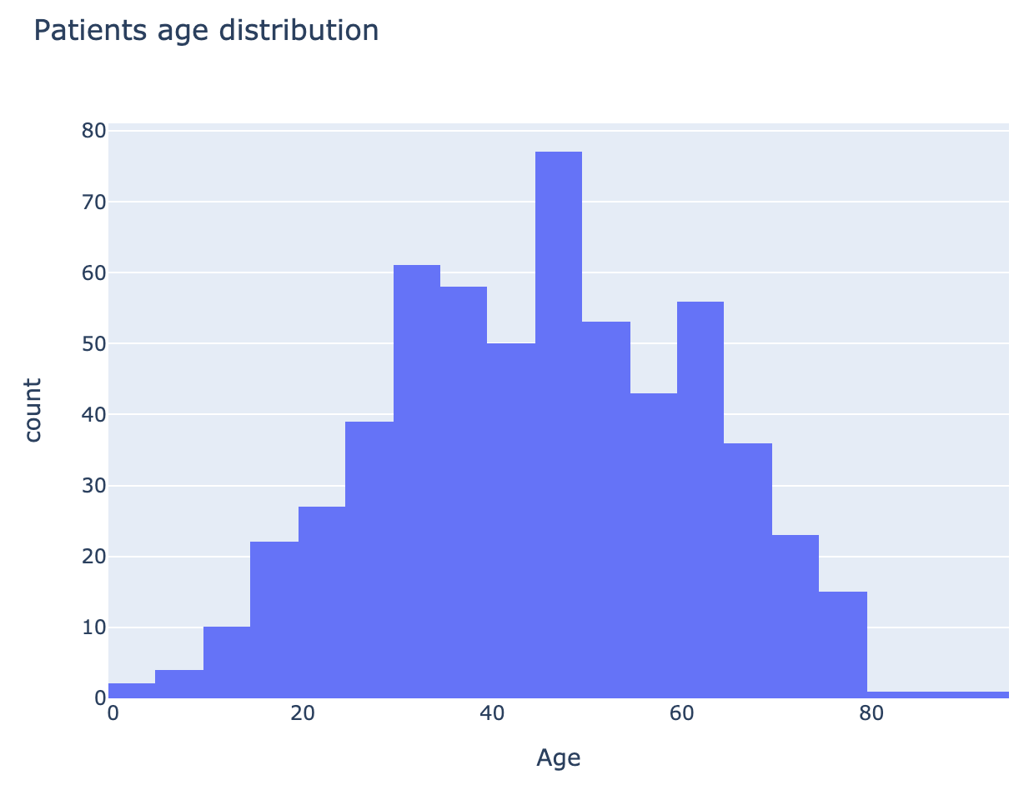
Results - EDA

Slide 7
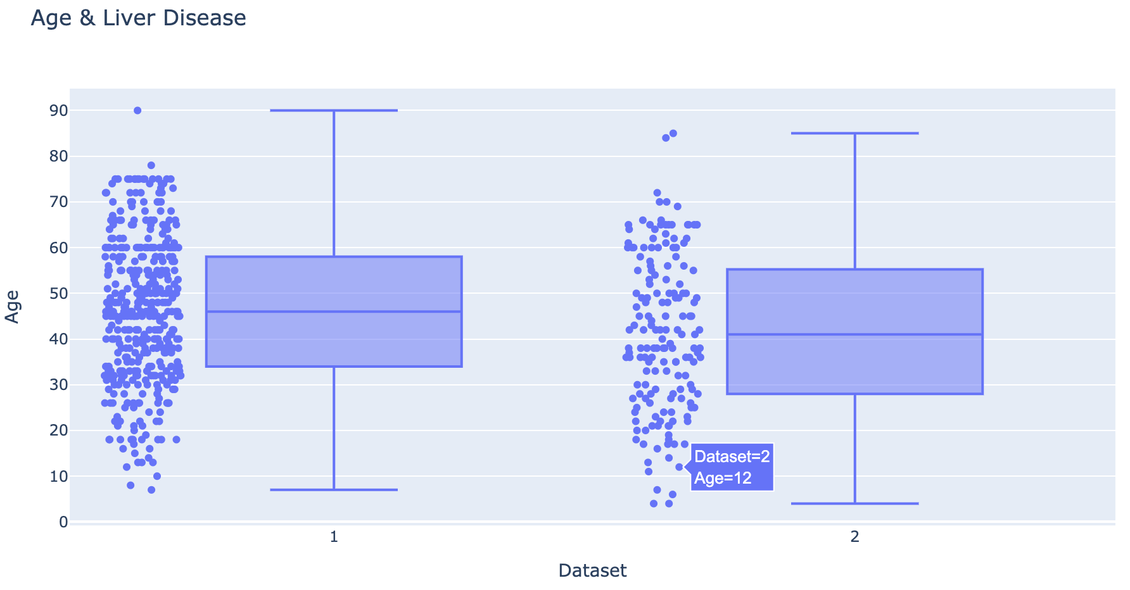
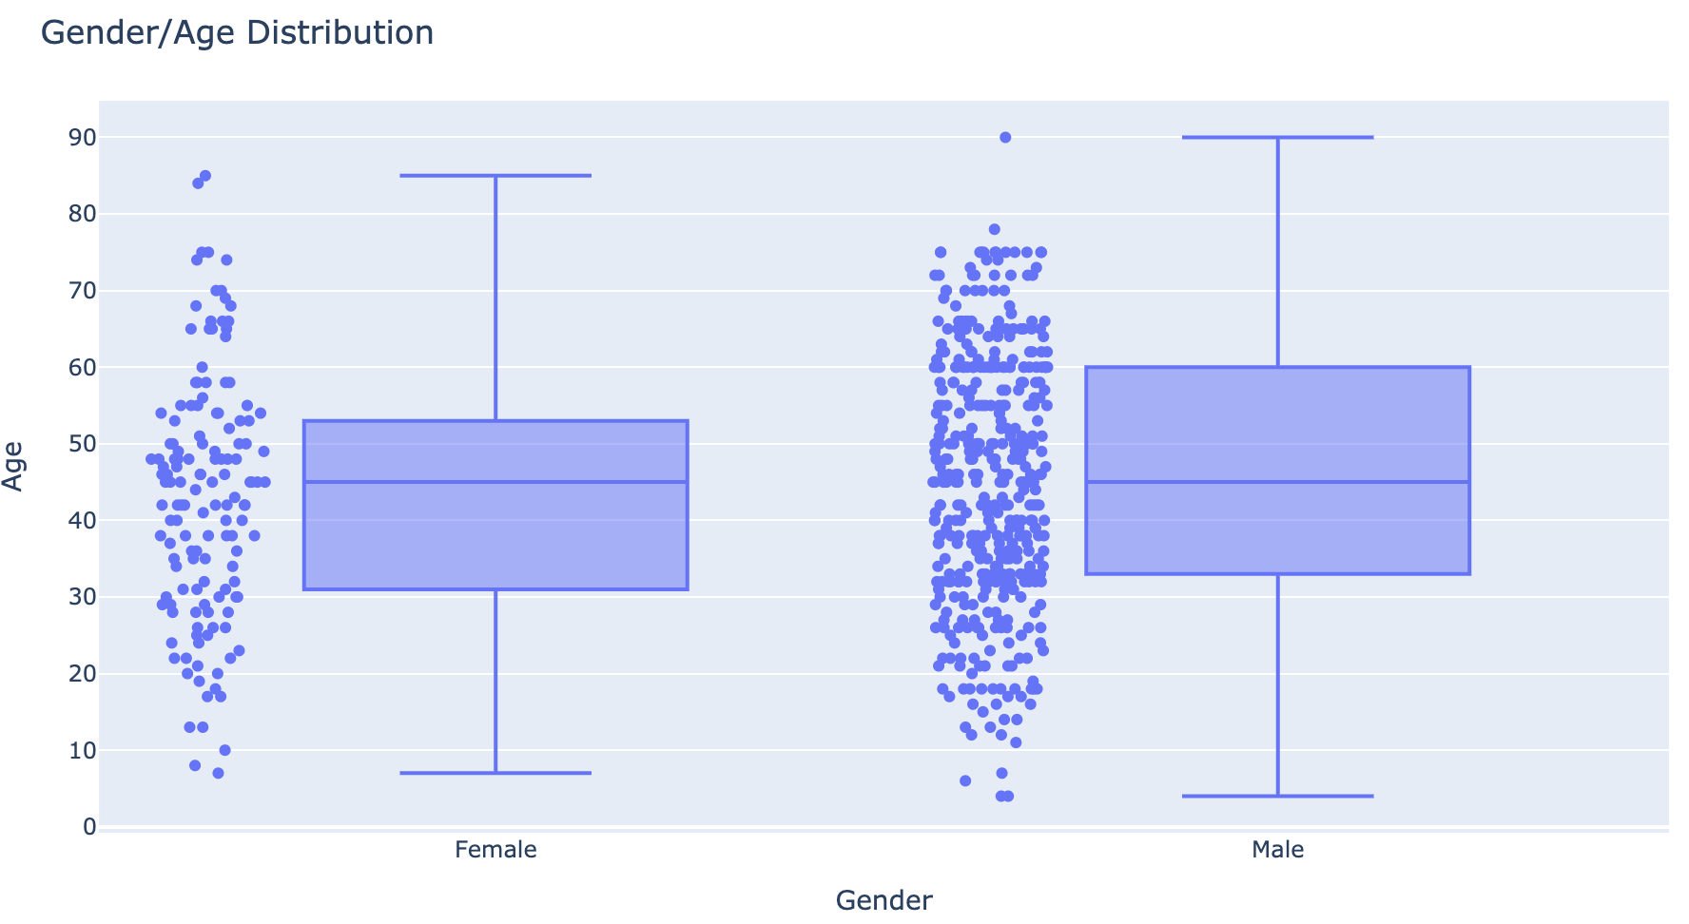
Results – EDA

Slide 8
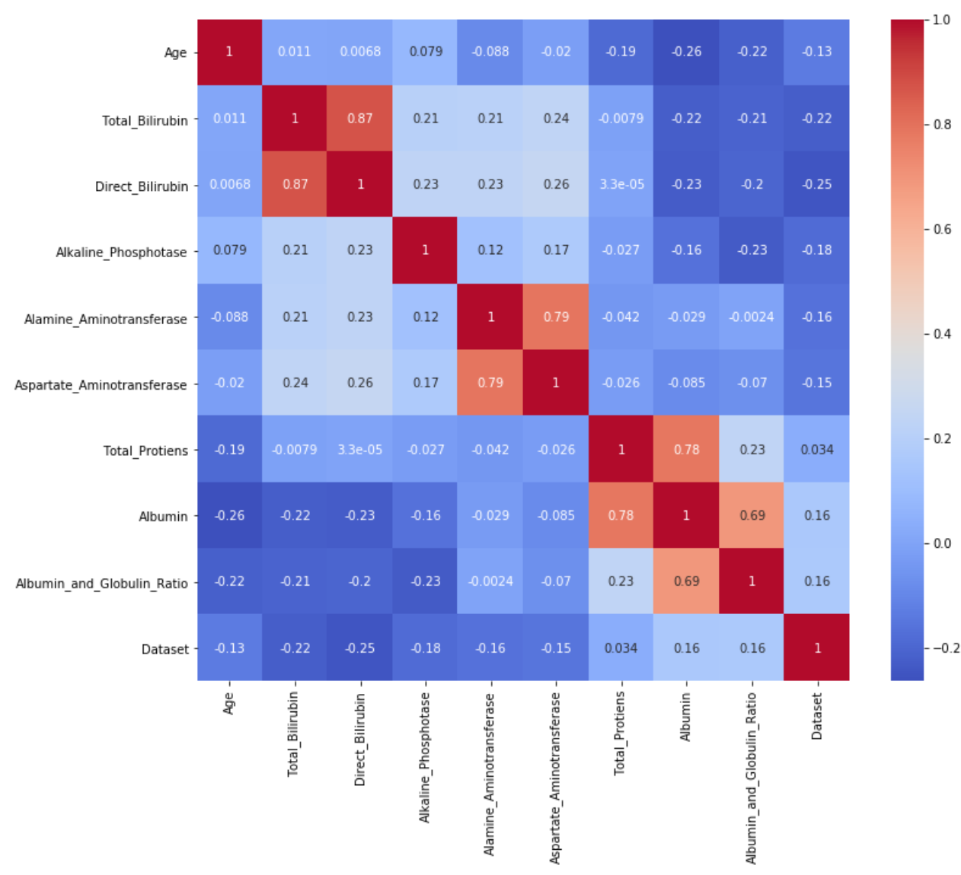
Results – EDA

Slide 9
Results – Predictive Analysis
Logistic Regression
K-Nearest Neighbor (KNN)
Decision Tree
Random Forest
Support Vector Machine (SVM)

Slide 10
Conclusion

Slide 11
Thank you

